Slide 1
CS 4460 Info Vis Readings

Slide 2
Choosing colors for data Vis
Principles of Color Design
Contrast and Analogy: contrast draws attention, analogy groups
Three dimensions (contrast and analogy can be applied to any of the three color dimensions)
Hue: color name
Value: lightness of darkness (两种颜色做一个渐变过渡条，条上的颜色就是不同value)
Chroma: describes colorfulness(saturation)

Slide 3
Choosing colors for data Vis
Legibility (易辨认性)
Difference in value: the single factor that determines legibility (differences in hue and chroma has no contribution at all).
Different in value specifies luminance contrast, which is the perceptual stimulus that the human visual system uses to detect edges.
Variation in luminance can separate overlaid values into layers without causing visual clutter (while contrast in hues does not create this separation).

Slide 4
Choosing colors for data Vis
Conclusion: guidelines for selecting colors
Use contrast to highlight
Analogy to group
Control value difference for legibility.
Limiting hue to a palette of two or three colors (minimizes an over-dependence on hue variation, which can cause visual clutter), using hue and chroma variations within these hues to create distinguishably different colors.

Slide 5
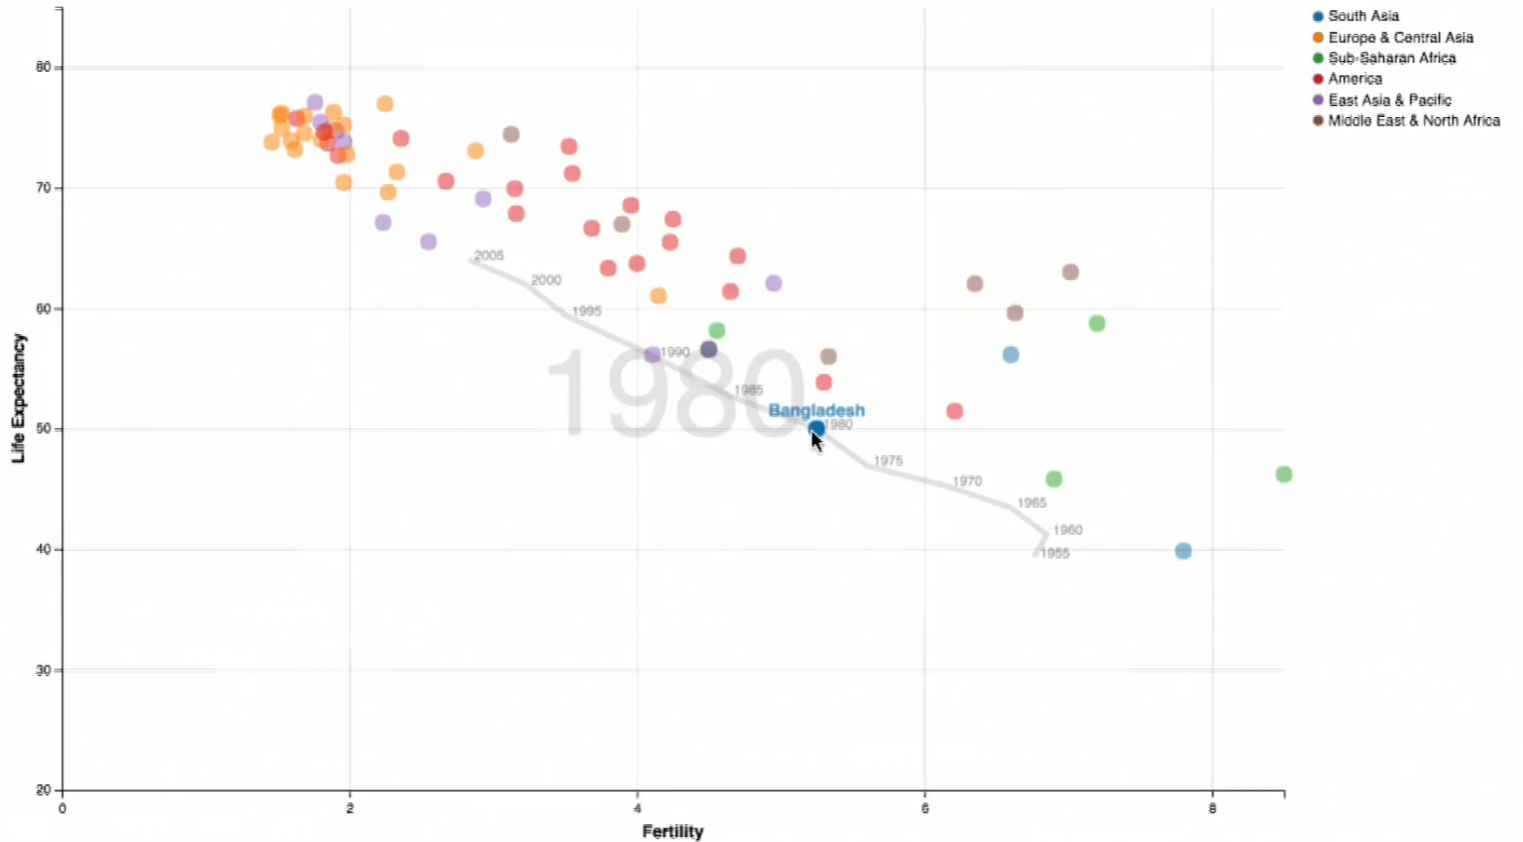
Constructing Charts and graphs
Use both visual encoding and interaction strategies.
Point shows fertility against population of multiple countries.
Put the mouse on a point shows other hidden points along the time trajectory corresponding to that particular country.
As you draw your mouse along a time trajectory of a particular country, points representing other countries also move to the place according to the time

Slide 6
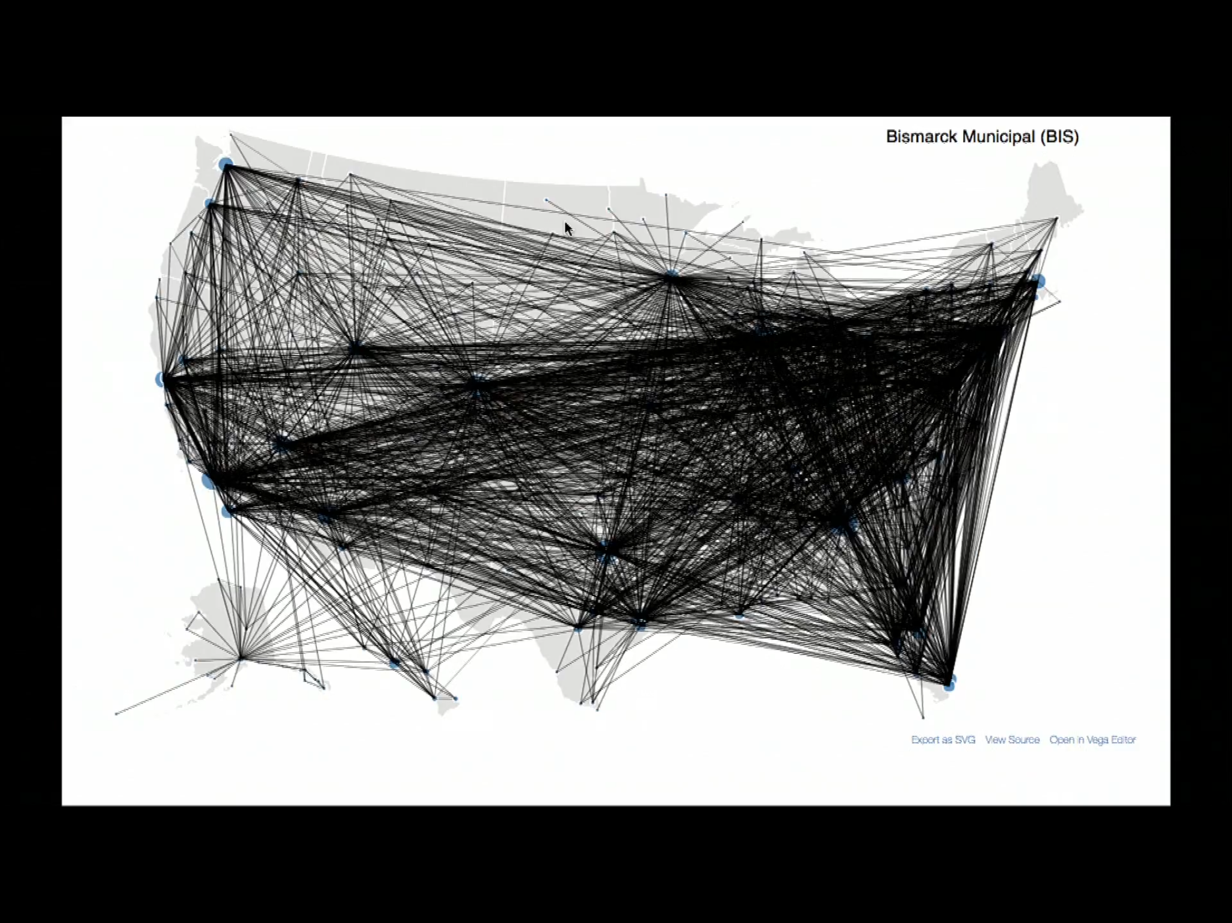
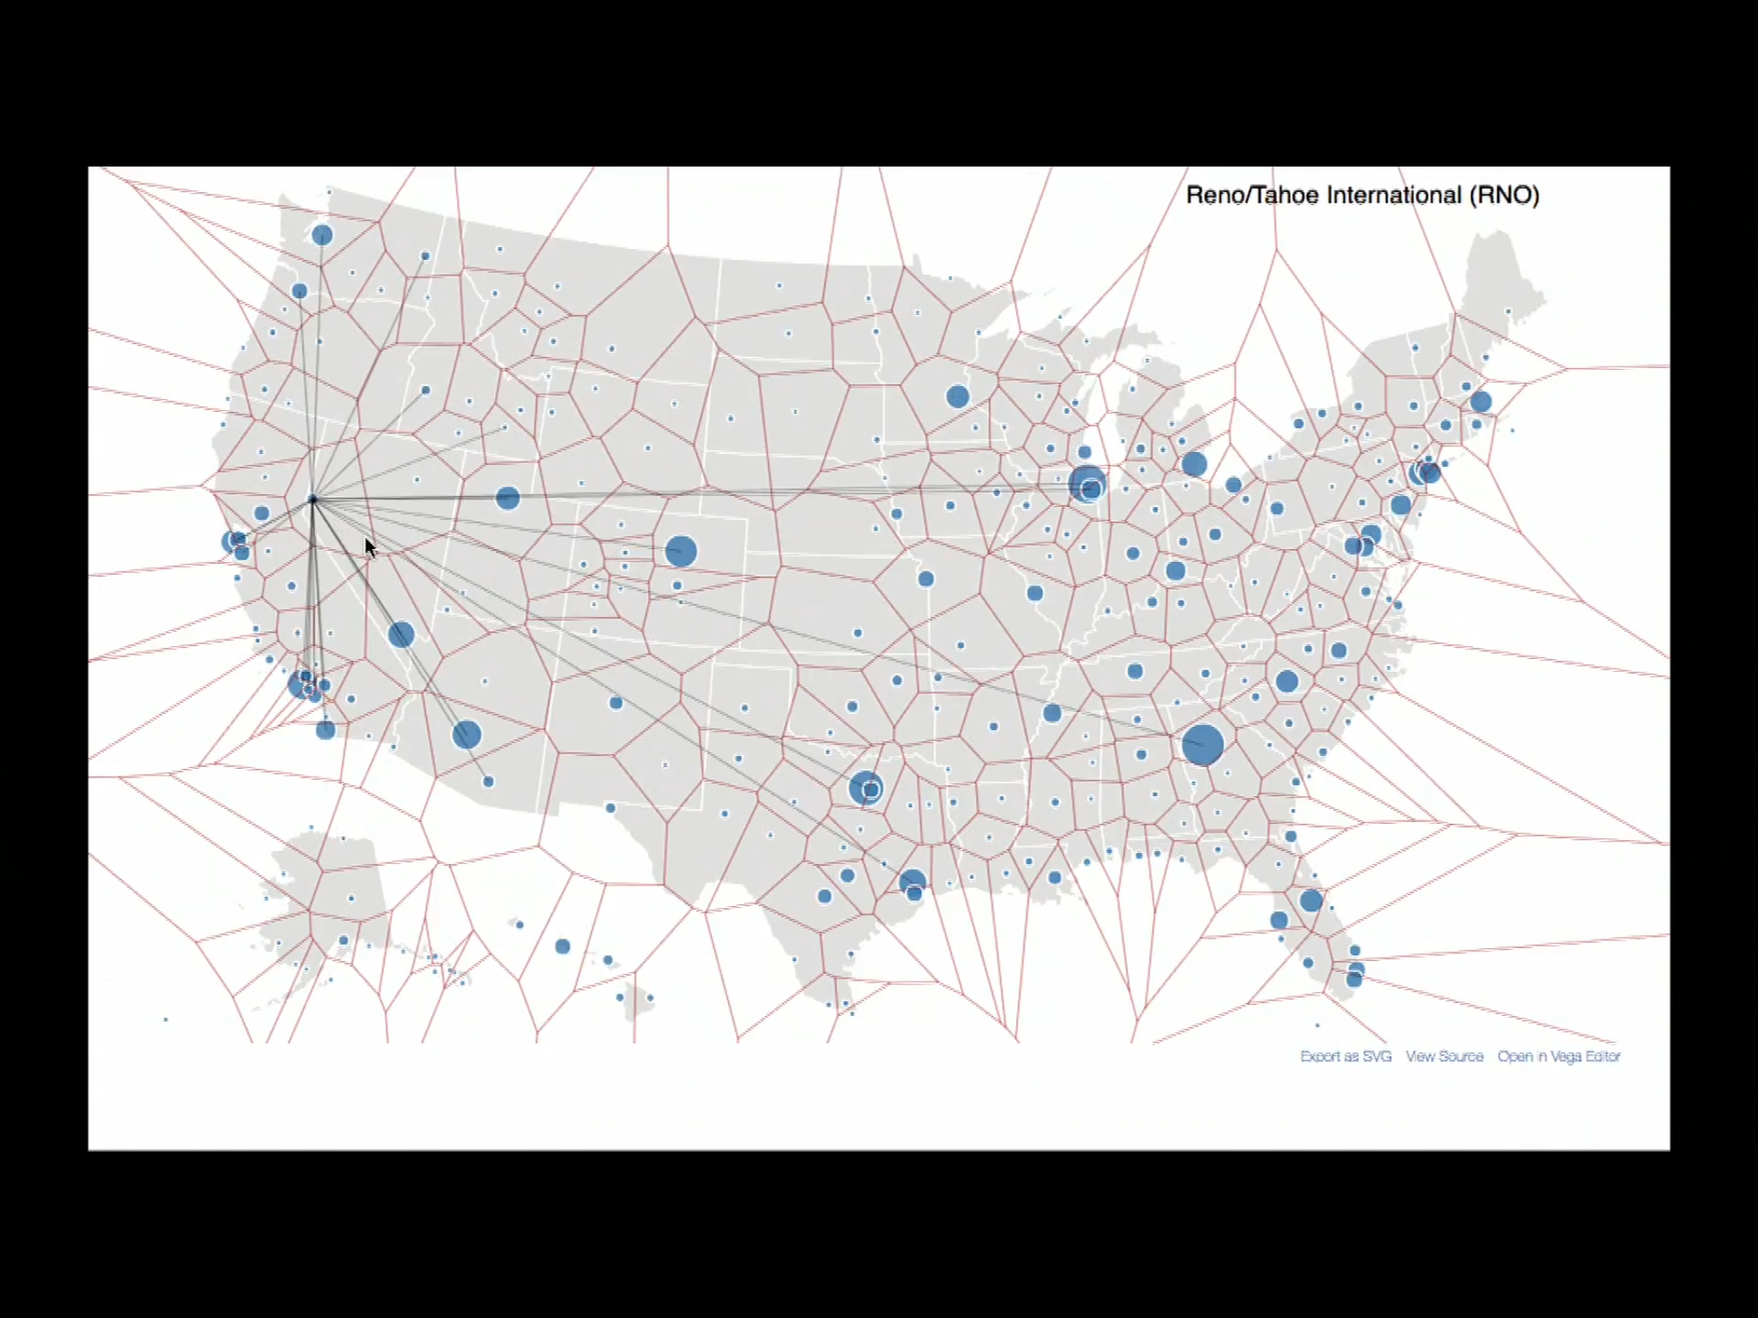
Constructing Charts and graphs
American map that shows all the airlines: too messy. Make all the lines invisible. Show the airlines from one particular airport once you move the mouse to the city.
Further, divide the map into regions, points in the same region share the same nearest airport. Thus, once you move the mouse within one region, it shows the airlines corresponding to the airport at the “center” of the region.
Accelerates the search time

Slide 7
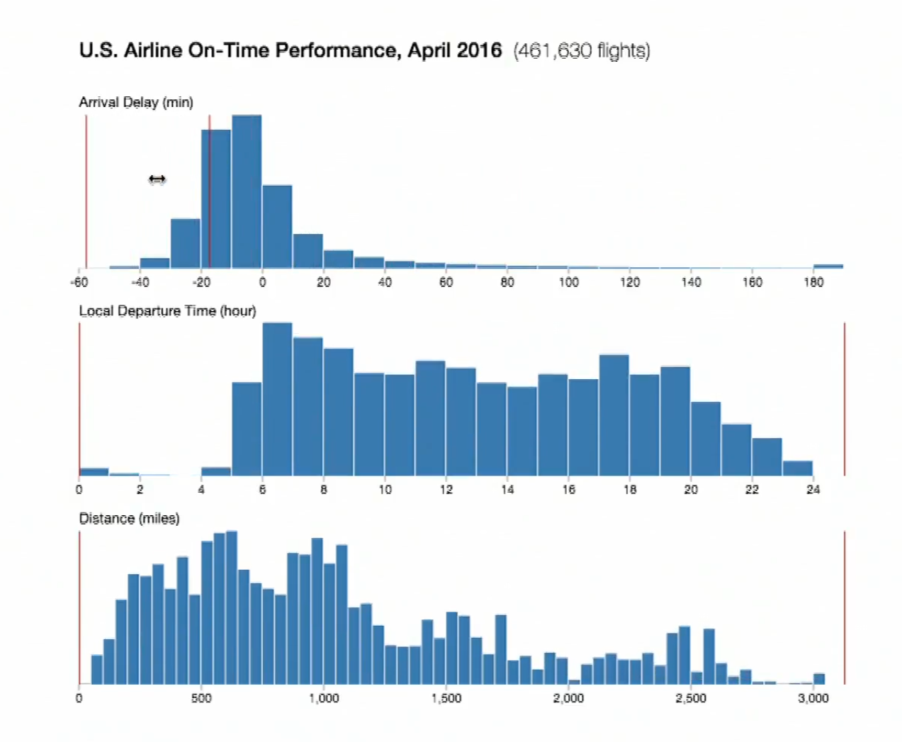
Constructing Charts and graphs
US Airline On-Time Performance.
Three histograms showing arrival delay, local departure time and flight distance.
Select a particular sub-region in the first histogram and see the distribution of departure time as well flight distance subject to “delay interval” specified.

Slide 8
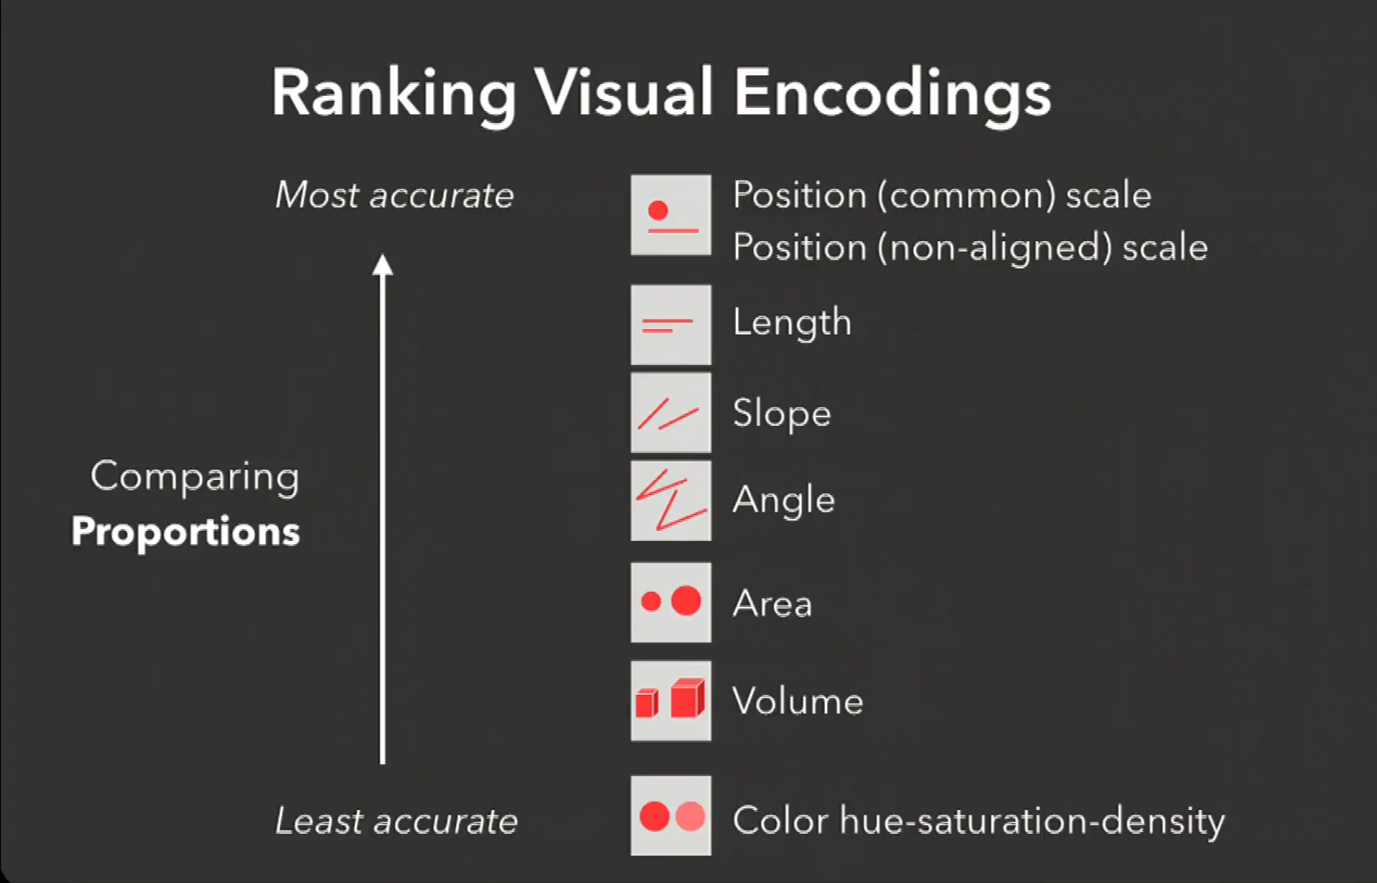
Constructing Charts and graphs

Slide 9
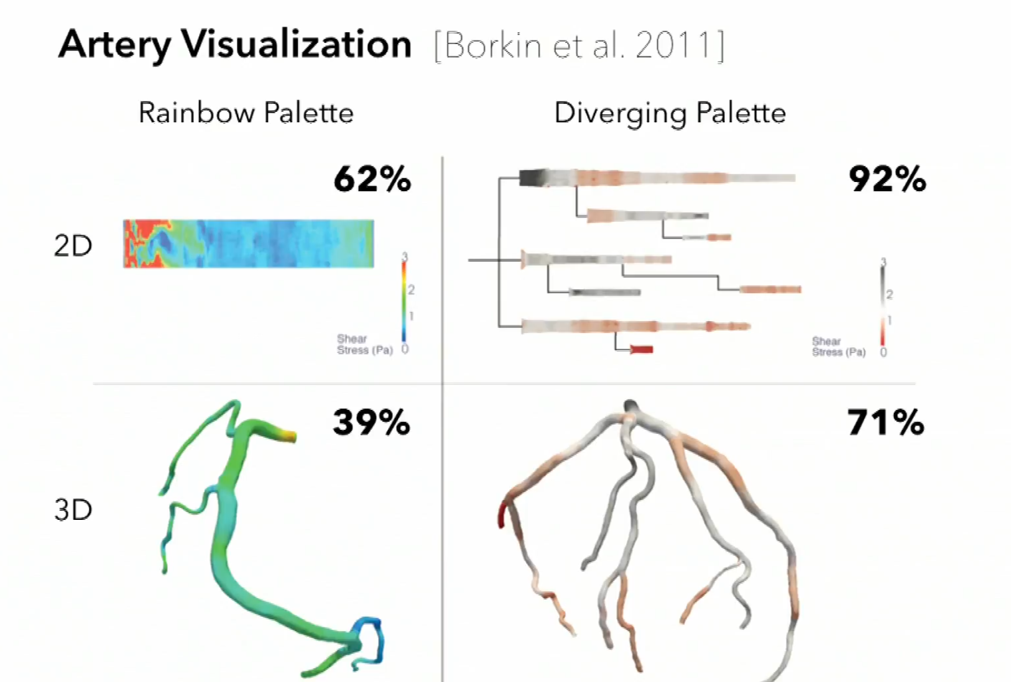
Constructing Charts and graphs
Increase 50% of diagnosing accuracy by making judicious choices (use 2D to represent 3D, change the color scheme) of how the data gonna to be visual encoded.

Slide 10
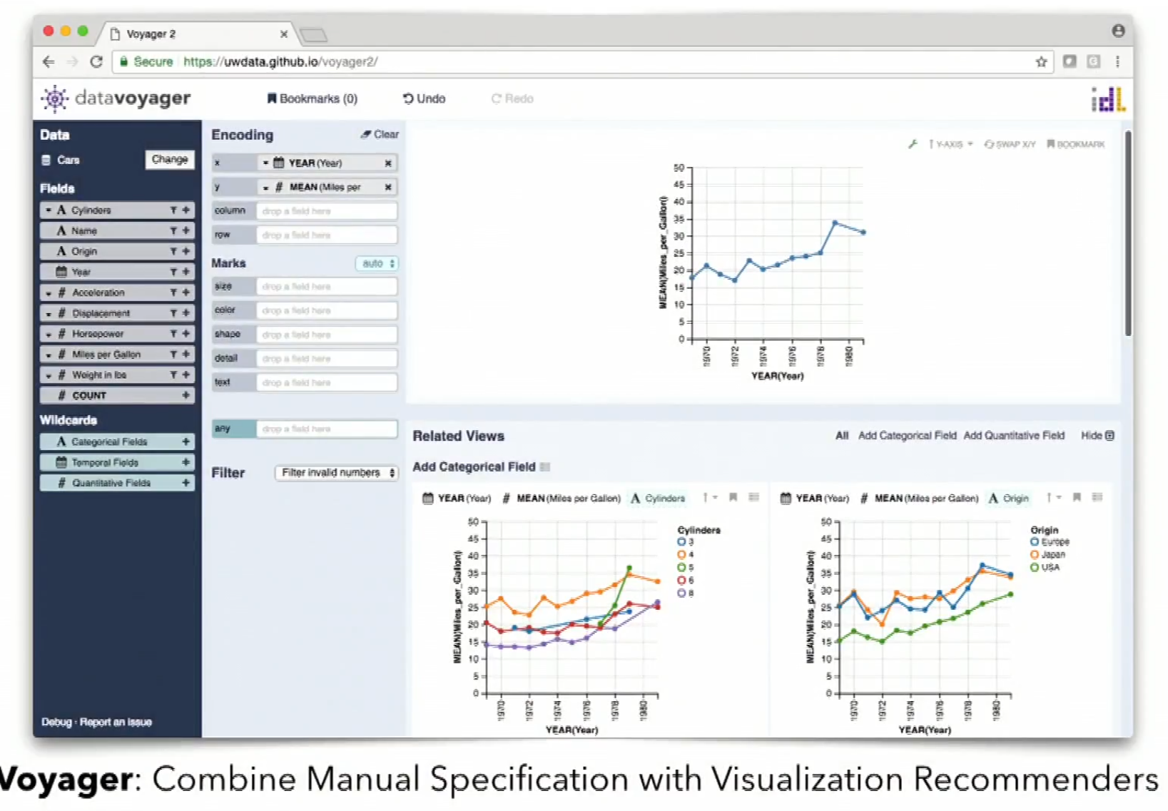
Constructing Charts and graphs
Data voyager
Choose a pivot view and it makes suggestion about related views that you may what to look at.
Helps accelerate exploration a lot.
Teach people what fields to include in order to see a specific aspect of the dataset.
Have to balance automation and user control.

Slide 11

Constructing Charts and graphs
Balancing Automation and User Control
Loss of critical engagement and domain expertise
Sometimes too much user control has the weakness of cognitive biases. Lack of global context -> overweight local information
Strategy: shared representiations & actions.

Slide 12
Constructing Charts and graphs
Some implications:
It is essential to have convenience of interaction of people and intermediate results.
At all stages of data analysis, the outputs need to be matched to the capabilities of the people who use it and want it.

